Slide 1
Project 1: Pandas Visualization
The Economic Impact of Covid-19
Elijah Chandra, Lendl Lampa, Keith Louis
2021/07/08

Slide 2


Slide 3


Covid-19 has stifled global economies since the beginning of 2020. Cases rose to insurmountable levels at a rapid pace and economies were forced to shut down in the efforts to control the spread of the virus.
This lead the team to discuss and ask how the pandemic has affected a country’s mobility and GDP.

Slide 4
Questions
How do the countries compare in regards to Covid-19 cases, related deaths and vaccination?
To figure out the effects of the pandemic, we needed a case count that can be referenced. We believe that knowing each country’s case numbers can help find correlations to the changes in an economy. Also, the case numbers can help us understand, if the citizens of the country are more willing to take the vaccine if the cases are higher.
How has the pandemic affected us in terms of mobility?
To further discuss the impact of the pandemic towards the changes in day-to-day human activities and how it might impact the economy, we extracted informations in several industries that we believe plays a big role in a country’s GDP.
How has Covid-19 affected the labour force and a country’s GDP?
How has Covid-19 affect the global economy, and how were specific global measures impacted. The data showed that there were significant declines in Global GDP during 2020, however the reason for the decline could not be adequately determined without sufficient research and available data. It was also significantly necessary to analyze the effects of covid on the labour force since mobility was affected by the pandemic.

Slide 5
The Data
The data used throughout the project consisted of:
Data on the number of cases, deaths, and vaccinations
Latitude and Longitude
Data on the mobility activities of a country’s citizens
Retail and Recreation, Groceries, Pharmacies, Workplaces, Transit Stations, and Driving
Data on a country’s change of GDP
Data on Employment Rates

Slide 6
Data Cleanup and Exploration
Cases Dataset
Read through the dataset and checked the values of each column
Original dataset had 40+ columns.
Decided which columns to use
Datasets contained irrelevant information and columns had to be dropped
Certain datasets carried NaNs, kept due to keeping the datasets true to form
Columns were grouped to show desired outcomes for plots
Datasets were filtered to show a particular set of countries
Latitude and longitude dataset

Slide 7
Data Analysis
How do the countries compare in regards to Covid-19 cases, related deaths and vaccination?
Total cases shows 3 countries with the most amount of cases compared to the other 7 countries
United States, India, Brazil
Citizens were quick to accept the vaccines right at rollout.
India’s cases continue to rise
The amount of people vaccinated is almost double that of people fully vaccinated
Except for the United States and United Kingdom.

Slide 8
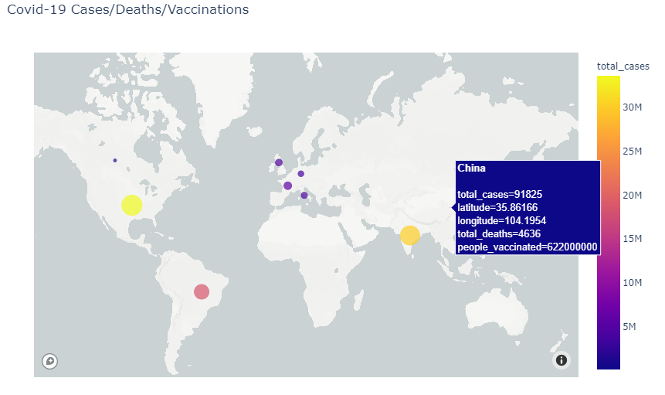
World Map

Slide 9
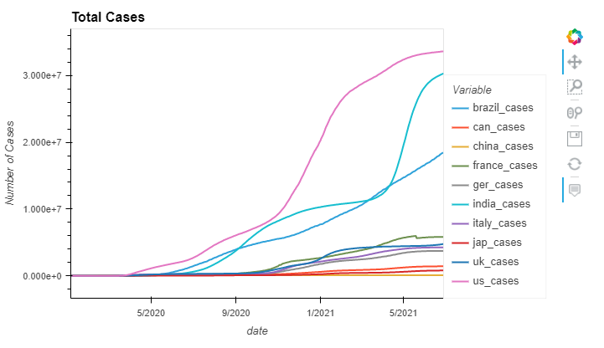
Total Cases

Slide 10
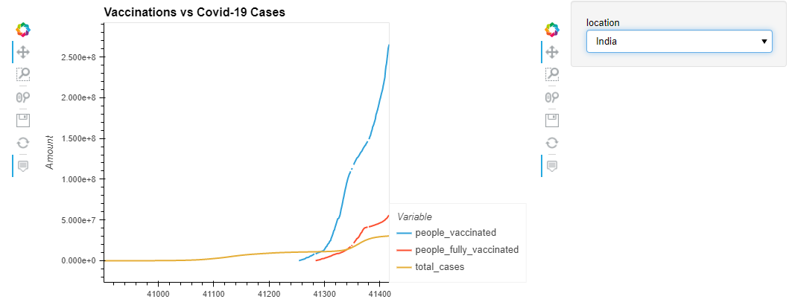
Vaccinations

Slide 11

Are We Becoming Less Mobile?

Slide 12
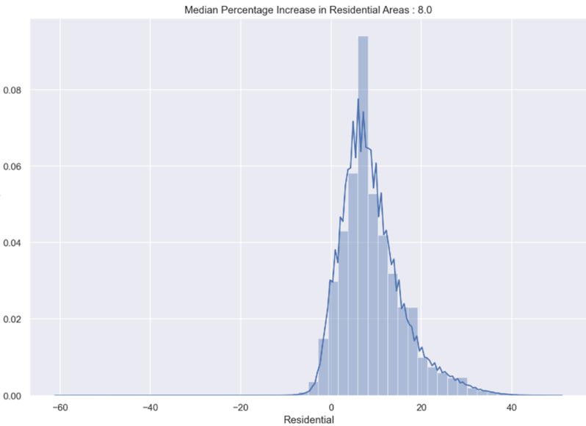
Residential Activities

Slide 13
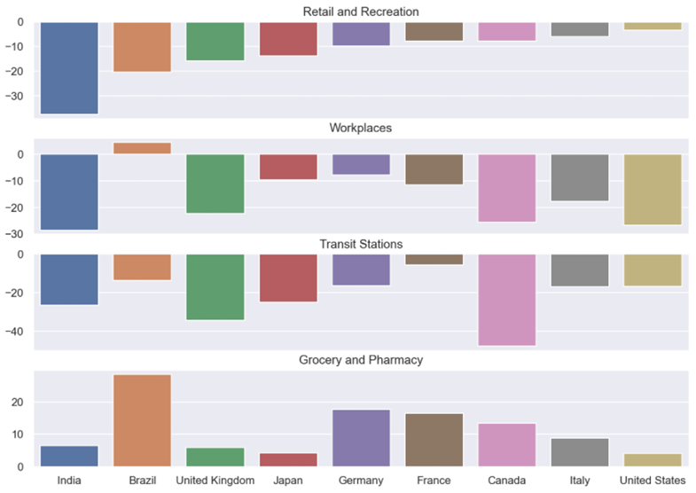
Changes in Visits to Other Activities
Fewer visits to retail and recreational places, workplaces, transit stations
More visits in groceries and pharmacies
A drop in Canada’s transit usage following the pandemic.

Slide 14
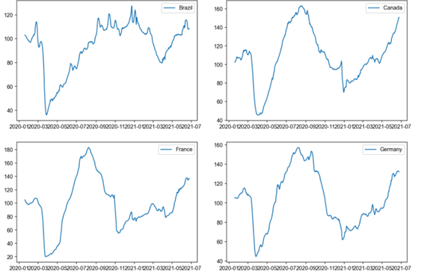
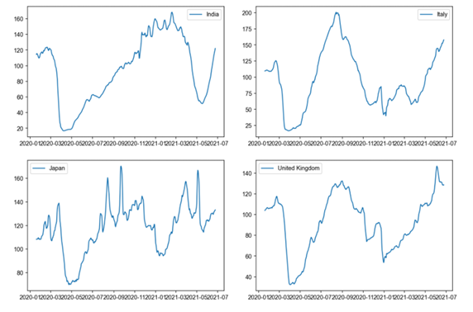
Commuting Trends in All Countries
Significant drops in driving are seen when the pandemic began. As we get closer to the current date, we see trends in all countries of people being more confident commuting.

Slide 15

How is a country’s economy measured?
To answer this question and to further describe Covid-19’s impact on the global economy we have taken an in depth look at five economic measures in relation to the pandemic.
1. GDP
2. GDP growth rate
3. Inflation Rate
4. GDP per Capita
5. Employment Rate
Notes:
As you have heard described by my colleagues, Covid-19 has had a significant impact on the way we live. To flatten curve of the COVID-19 pandemic the world has been forced to come to a standstill. Streets are empty, shops are closed, and people are out of work, public gatherings have been banned in many places and travel restrictions have been imposed. And all of this is having a major impact on the global economy. The United Nations says we may see a $2 trillion US Dollar shortfall in our global income and a $220 billion hit to developing countries because of COVID-19.

Slide 16
Gross Domestic Product (GDP) (in Trillion U.S. dollars)
GDP, or gross domestic product, is effectively a count of the total goods and services produced in a country over a certain period. It is calculated by first adding together a country’s total consumer spending, government spending, investments, and exports; and then deducting the country’s imports.
Notes:
The values in this statistic are the change in ‘constant price’ or ‘real’ GDP, which means this basic calculation is also adjusted to factor in the regular price changes measured by the respective countries.
This segment of project 1, looks into the impact of the corona virus on the global economy in 2020, with specific attention being placed on the world's seven largest economies and Canada. We intend to illustrate the coronavirus (COVID-19) pandemic outbreak effect on Global Gross Domestic Product which has declined by 6.7 percent, in comparison to a World GDP growth rate for 2019 which was 2.36%.
Out of the world's seven largest economies, the United Kingdom was the most negatively affected by the coronavirus (COVID-19) pandemic. As of the third quarter of 2020, the GDP growth rate of the UK stood at minus 9.6 percent compared to the previous year. Furthermore, the GDP of India was contracted by minus 7.5 percent. Only China experienced a positive GDP growth rate of 4.9 percent during that same period.
Owing to the economic effects of the coronavirus (COVID-19) pandemic, real U.S. GDP increased by 6.4 percent in the first quarter of 2021. This compares to an increase of 2.4 percent in the fourth quarter of 2019, but a decline of 2.3 percent at the commencement of the spread of COVID-19 around the world.

Slide 17
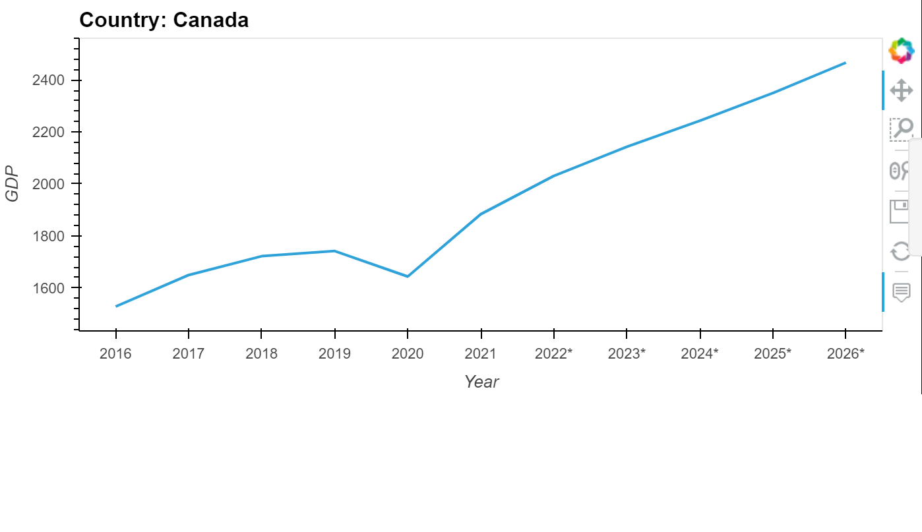
GDP per Country

Slide 18
The GDP for the 9 biggest economies and Canada for 2020 were as follows:
United States (GDP: 20.93 trillion)
China (GDP: 14.72 trillion)
Japan: (GDP: 5.048 trillion)
Germany: (GDP: 3.80 trillion)
United Kingdom: (GDP: 2.71 trillion)
France: (GDP: 2.60 trillion)
India: (GDP: 2.71 trillion)
Italy: (GDP: 1.88 trillion)
Brazil: (GDP: 1.43 trillion)
Canada: (GDP: 1.64 trillion)

Slide 19
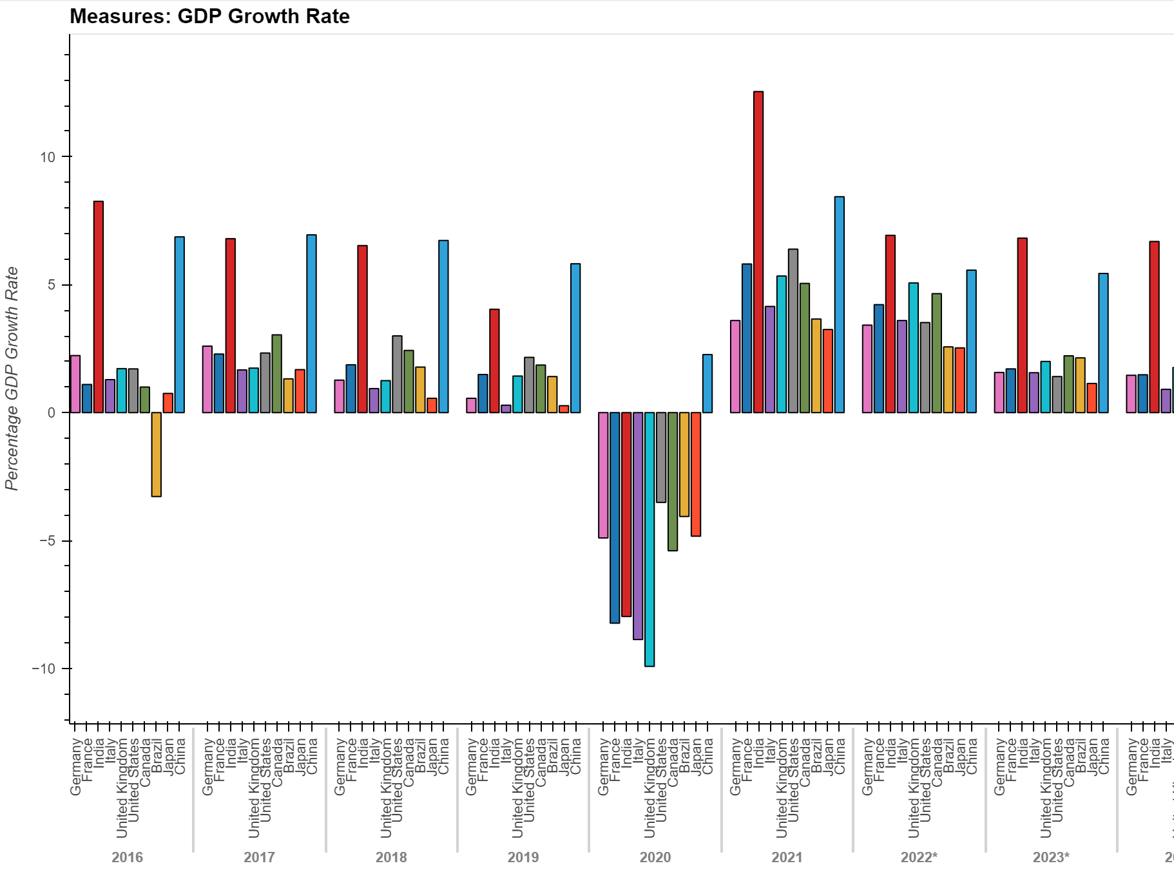
GDP Growth Rate (%) In comparison, Covid-19 impact on GDP on the Global Economy can also be illustrated by the GDP growth rate and it is illustrated as follows:
Notes:
The statistic shows the gross domestic product growth rate in Canada for example from 2016 to 2020, with projections up until 2026. In 2020, Canada’s real GDP growth was around -5.4 percent compared to the previous year. Except for China with a positive GDP growth rate of 2.270 percent in 2020, every country showed a negative GDP growth with the United Kingdom most affected by the pandemic with a recorded GDP growth rate of -9.920 percent, realising a decline of 11.35 percent from 2019.

Slide 20
Inflation Rate (%)
Inflation is the rate at which the value of a currency is falling and consequently, the general level of prices for goods and services is rising.
Notes:
The inflation rate during covid-19 has shown a noticeable decline in 2020 for Italy with that country showing a deflation or negative inflation. Give rise to the fact that the supply of goods was higher than the demand for those goods. It may also be due to the buying power of money becoming greater.

Slide 21
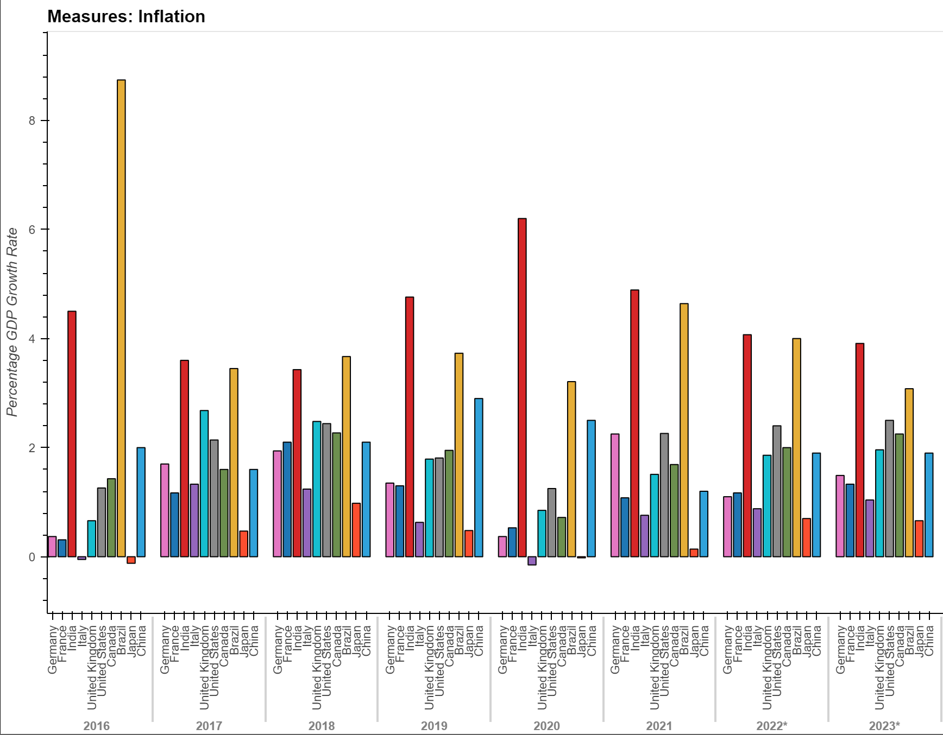
Inflation Chart

Slide 22
GDP per Capita (In U.S. dollars)
Another noticeable measure of the coronavirus’ impact on the global economy is the GDP per Capita.
The gross domestic product per capita, or GDP per capita, is a measure of a country's economic output that accounts for its number of people. It divides the country's gross domestic product by its total population.
Notes:
The statistic shows the growth of the real gross domestic product (GDP) in Canada and the G7 countries from 2016 to 2021, with projections up until 2026 and by dividing that sum by population, we arrive at the GDP per Capita. As mentioned earlier GDP refers to the total market value of all goods and services that are produced within a country per year. It is an important indicator of the economic strength of a country. Real GDP is adjusted for price changes and is therefore regarded as a key indicator for economic growth. In 2020, India's gross domestic product per capita was at about $1964.88 (us dollars) compared to the previous year of $2098.93 US. At its most basic interpretation, GDP per capita shows how much economic production value can be attributed to each individual citizen.
The IMF expected GDP globally of 3.2% in 2019 with a slight pickup in 2020 to 3.4%. Trade and Technology relations are at the forefront of concerns that could affect the growth of GDP and per Capita GDP. Covid-19 pandemic threw these projections off but the forecast for the following years shows that when some semblance of normalcy does return, per capita GDP metrics should regain the relevancy.

Slide 23
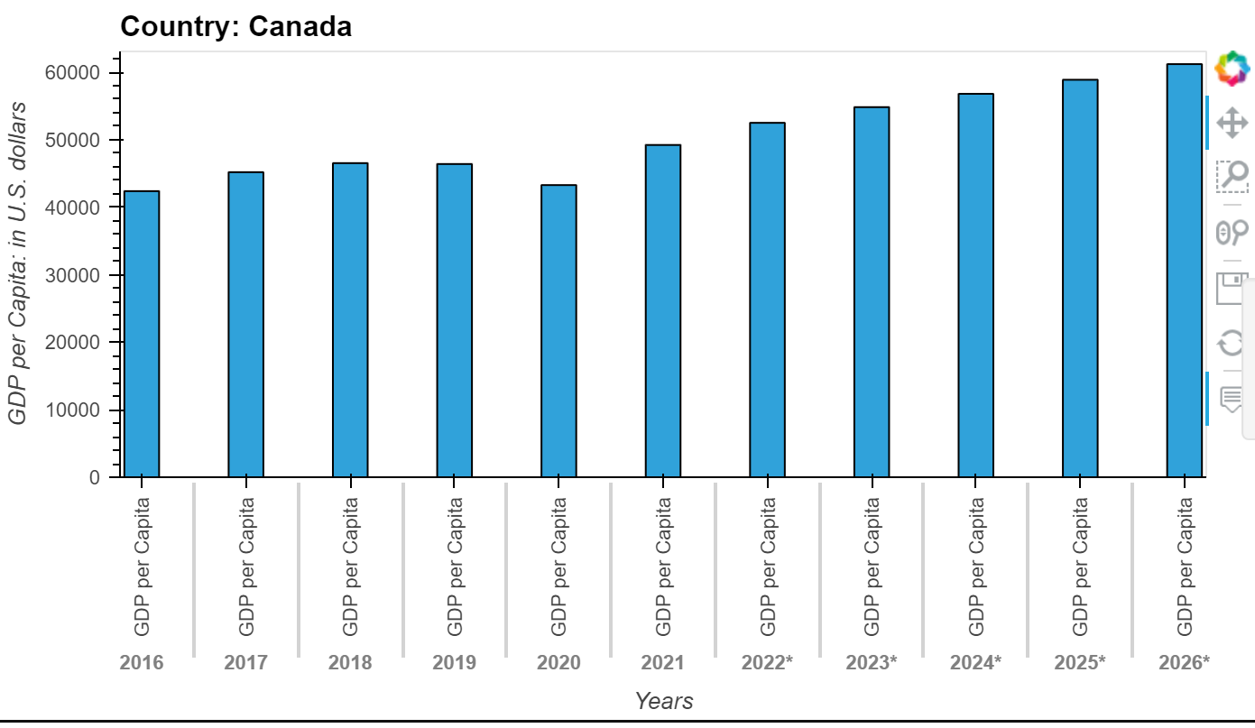
Countries GDP per Capita Chart

Slide 24
Employment rate (%)
The unemployed are people of working age who are without work, are available for work, and have taken specific steps to find work. The uniform application of this definition results in estimates of unemployment rates that are more internationally comparable than estimates based on national definitions of unemployment. This indicator is measured in numbers of unemployed people as a percentage of the labour force, and it is seasonally adjusted. The labour force is defined as the total number of unemployed people plus those in employment.
Notes:
The unemployed are people of working age who are without work, are available for work, and have taken specific steps to find work. The uniform application of this definition results in estimates of unemployment rates that are more internationally comparable than estimates based on national definitions of unemployment. This indicator is measured in numbers of unemployed people as a percentage of the labour force, and it is seasonally adjusted. The labour force is defined as the total number of unemployed people plus those in employment. Data are based on labour force surveys (LFS). For European Union countries where monthly LFS information is not available, the monthly unemployed figures are estimated by Eurostat.

Slide 25
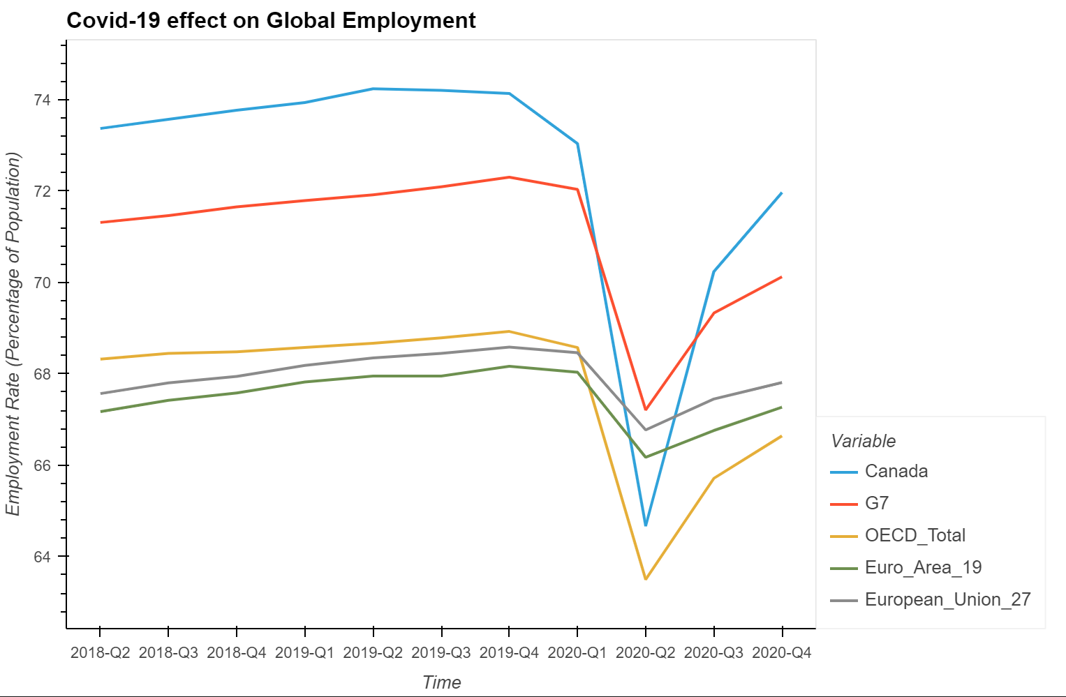
Covid-19 Impact on Global Employment: Chart
Notes:
In the United States, the unemployment rate fell marginally in February 2021 (to 6.2%, from 6.3% in January), along with a decline in the number of people on temporary lay-off, while in Canada it decreased by 1.2 percentage points, to 8.2%. More recent data show that in March, the unemployment rate declined further in the United States (by 0.2 percentage point, to 6.0%) and Canada (by 0.7 percentage point, to 7.5%). This decrease has been attributed to the rate of vaccinations administered so far and the comfort level of the global population on a whole to venture out to seek employment.
By the end of the 4th quarter of 2020, as the line graph illustrates the trend in the unemployment rate per quarter, there was an increase in the employment rate and therefore a decrease in unemployment for the G7 countries, Canada, European area, European Union and finally the OECD-Total (Organization for Economic Co-Operation and Development). This total is the unemployment rate of (people aged 15 to 24) globally.
Though it isn’t illustrated by country, it should be noted that Covid -19 can be attributed to the unemployment rate increased by 0.5 percentage point in Israel (to 5.1%) and was stable in Japan (at 2.9%) and Mexico (at 4.5%).
Another noticeable mention is The OECD Youth unemployment rate (people aged 15 to 24) decreased to 13.7% in February 2021, from 14.0% in January of 2021, showing the comfort of a vaccinated global population.
More generally, it should be noted that unemployment statistics do not account for the full amount of labour market slack due to Covid-19, as some non-employed people may be classified as “out of the labour force”, because, due to the pandemic, they are either not able to actively look for a job or are not available to work.
Canada is one of the largest economies in the world and is counted among the globe’s wealthiest nations. It has a relatively small labor force in comparison to some of the world’s other largest economic powers, amounting to just under 19 million. Unemployment in Canada has remained relatively high as the country has battled against the tide of economic woe that swept across most of the world after the 2008 financial meltdown, and although moving in the right direction, the pandemic in 2020 has not helped the unemployment rate, and thus Canada remains a long way from where it needs to be with its unemployment rate.

Slide 26
Postmortem
Lack of data from countries
A big question we really wanted answered was:
How did Covid-19 affect the emergence of new technologies and what has been adopted to combat the virus?
Scarce datasets
With more time, we can research individual technologies and come up with our own dataset to find relationships.

